Slide 1
DML
Data Manipulation Language
Commands: Insert, Delete, Update & select

Slide 2
Specifying Updates in SQL
There are three SQL commands to modify the database; INSERT, DELETE, and UPDATE

Slide 3
INSERT
In its simplest form, it is used to add one or more tuples/rows to a relation/table
Attribute values should be listed in the same order as the attributes were specified in the CREATE TABLE command

Slide 4
INSERT (cont.)
Example: INSERT INTO EMPLOYEE VALUES ('Richard','K','Marini', '653298653', '30-DEC-52', '98 Oak Forest,Katy,TX', 'M', 37000,'987654321', 4 );

Slide 5
INSERT (cont.)
Example: Insert a tuple for a new EMPLOYEE for whom we only know the FNAME, LNAME, and SSN attributes. INSERT INTO EMPLOYEE (FNAME, LNAME, SSN) VALUES ('Richard', 'Marini', '653298653’), (‘Ali’, ‘Ahmed’ , ‘123456889’);

Slide 6
DELETE
Removes tuples/rows from a relation
Includes a WHERE-clause to select the tuples/rows to be deleted

Slide 7
DELETE (cont.)
Examples:
DELETE FROM EMPLOYEE WHERE LNAME='Brown’;
DELETE FROM EMPLOYEE WHERE SSN='123456789’;
DELETE FROM EMPLOYEE WHERE DNO =5;
The number of tuples deleted depends on the number of tuples in the relation that satisfy the WHERE-clause

Slide 8
Delete (cont.)
A missing WHERE-clause specifies that all tuples in the relation are to be deleted; the table then becomes an empty table
DELETE FROM EMPLOYEE;

Slide 9
Delete (cont.)
Tuples are deleted from only one table at a time (unless CASCADE is specified on a referential integrity constraint)
Delete from employee
Where ssn = 123456789;

Slide 10
UPDATE
Used to modify attribute values of one or more selected tuples
A WHERE-clause selects the tuples to be modified
An SET-clause specifies the attributes to be modified and their new values

Slide 11
UPDATE (cont.)
Example: Change the location and controlling department number of project number 10 to 'Bellaire' and 5, respectively. U5: UPDATE PROJECT SET PLOCATION = 'Bellaire', DNUM = 5 WHERE PNUMBER=10;

Slide 12
UPDATE (cont.)
Example: Give all employees in the 'Research' department a 10% raise in salary. U6: UPDATE EMPLOYEE SET SALARY = SALARY *1.1 WHERE dno =5;
In this request, the modified SALARY value depends on the original SALARY value in each tuple
Notes:
The reference to the SALARY attribute on the right of = refers to the old SALARY value before modification
The reference to the SALARY attribute on the left of = refers to the new SALARY value after modification

Slide 13
Retrieval Queries in SQL : SELECT statement
SQL has one basic statement for retrieving information from a database

Slide 14
Retrieval Queries in SQL (cont.)
SELECT <attribute list>
FROM <table list>
WHERE <condition>
<attribute list> is a list of attribute names whose values are to be retrieved by the query
<table list> is a list of the relation names required to process the query
<condition> is a conditional (Boolean) expression that identifies the tuples to be retrieved by the query

Slide 15
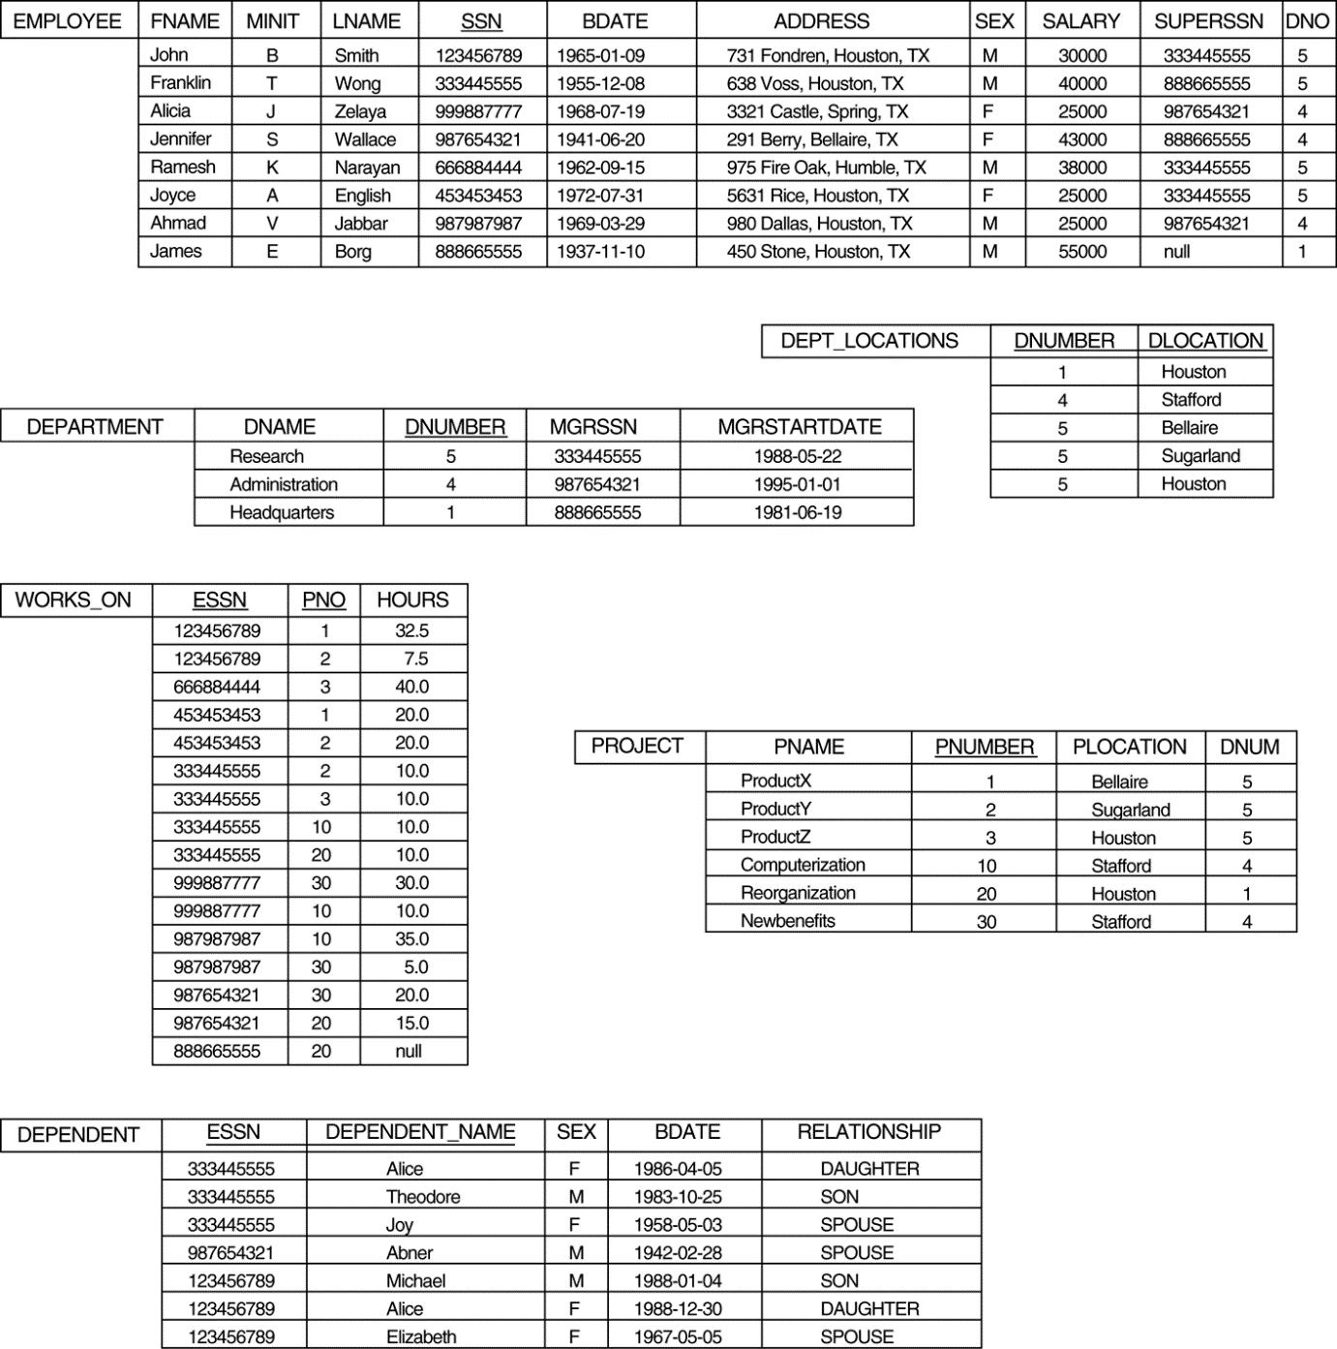
Populated Database--Fig.5.6

Slide 16
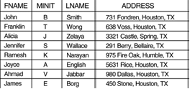
Simple SQL Queries (cont.)
Query: Retrieve the name and address of all employees.
SELECT FNAME,MINIT, LNAME, ADDRESS FROM EMPLOYEE ;

Slide 17
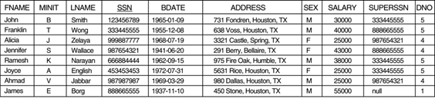
Simple SQL Queries (cont.)
Query: Retrieve the information of all employees.
SELECT * FROM EMPLOYEE ;

Slide 18
Simple SQL Queries
Query : Retrieve the birthdate and address of the employee whose name is 'John B. Smith'.
Q0: SELECT BDATE, ADDRESS FROM EMPLOYEE WHERE FNAME='John' AND MINIT='B’ AND LNAME='Smith’;

Slide 19
Operator: IS/IS NOT
Query: show employees who are not working in any department.
Select *
From employee
Where dno IS NULL ;

Slide 20

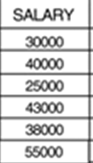
USE OF DISTINCT: To eliminate duplicate tuples in a query result, the keyword DISTINCT is used
SELECT DISTINCT SALARY FROM EMPLOYEE;
SELECT SALARY FROM EMPLOYEE;

Slide 21
ORDER BY
The ORDER BY clause is used to sort the tuples/row in a query result based on the values of some attribute(s)
The default order is in ascending order of values
We can specify the keyword DESC if we want a descending order; the keyword ASC can be used to explicitly specify ascending order, even though it is the default

Slide 22
ORDER BY (cont.)
Show all employee names in ascending order of their names.
Select Fname , Minit, Lname
From employee
Order by Fname;

Slide 23
ORDER BY (cont.)
Show all employee names in descending order of their names.
Select Fname , Minit, Lname
From employee
Order by Fname desc;

Slide 24
Comparison Operator BETWEEN
Query:
Retrieve all employees in department 5 whose salary is between 30,000 and 50,000
SELECT *
FROM EMPLOYEE
WHERE (Salary BETWEEN 30000 AND 50000) AND DNO =5 ;
SAME AS
(Salary >= 30000)AND (Salary <= 50000)

Slide 25
ARITHMETIC OPERATIONS
The standard arithmetic operators '+', '-'. '*', and '/' can be applied to numeric values in an SQL query result
Query Show the effect of giving all employees who work in department no 5 a 10% raise.( in reality database k upar apply nhi hou rha , bss select k through apply kr rhy hain , select is just used to retrieve data tou jou data retrieve houga usky upar bss arithmetic operation ka result dikhaey ga lekin in actuality usky upar apply nhi krey ga ). Q: SELECT FNAME, LNAME, 1.1*SALARY FROM EMPLOYEE WHERE dno =5;

Slide 26
Practice operators: <,>,<=,>=, <>
Show fname of all employees.
Show fname and ssn of all employees.
Show fname, ssn and salary of all employees who earns 40,000.
Show fname, ssn and salary of all employees who earns more than 40,000 and are working in dnumber 5.
Show fname of emloyees who earns 30,000 or they are female.
Show information of employees who have no supervisor.
Select* from employees where supervisior is null;
Show fname of employees whose address is saved in our database.
Select* from employees where address is not null;( agar save nhi houga address tou null a rha houga)
Show uniques fname of all employees. Select distinct fname from employee;
Show employees who are working in department # 5 or earn between 20,000 and 40,000
Select* from employee whrere dno=5 or salary between 20000 and 40000;
Show information of all employees in descending order by their salaries.
Select* from employees order by salary desc;

Slide 27
SUBSTRING COMPARISON
The LIKE comparison operator is used to compare partial strings
reserved characters used: '%’ , ‘_’
% replaces an arbitrary number of characters i.e. 0 to n
'_' replaces a single arbitrary character i.e. only 1

Slide 28
SUBSTRING COMPARISON (cont.)
Retrieve all employees whose address is in Houston, Texas.
Here, the value of the ADDRESS attribute must contain the substring 'Houston,TX’.
SELECT FNAME, LNAME FROM EMPLOYEE WHERE ADDRESS LIKE '%Houston,TX%’

Slide 29
SUBSTRING COMPARISON (cont.)
Retrieve all employees who were born during the 1950s.
Here, '5' must be the 3rd character of the string (according to our format for date), so the BDATE value is '__5______', with each underscore as a place holder for a single arbitrary character. Q26: SELECT FNAME, LNAME FROM EMPLOYEE WHERE BDATE LIKE ‘195 _ _ _ _ _ _ _’

Slide 30
Practice Queries : LIKE / NOT LIKE
Show detail of employee whose first name starts with K and born in 1980.
Show detail of employee whose first name starts with J and last name does not end with d.
Show detail of department which has at least 3 alphabets in its name.
Show projects which has r in their name and it is on second position.
Show projects which does not has H in their name.
Show projects which does not has H on second position of their name.
Show name of dependent from dependent table, where dependent name starts with D and has at least 3 characters.
Show detail of employee whose first name starts with A and ends with A.
Show name of employee who have 5 digit salary.
Shaw name of employees who live in “Texas”.

Slide 31
Show employee names with their dept names? 24 records - 8 records = 16 faulty records
Select fname, Dname (3)
From employee, department (1)
Where employee.dno = department.dnumber; (2) // we are joining tables pk = fk
2 tables = 1 join condition
3 tables= 2 join conditions
Salary >1000 (query condition )
OUTPUT
John Research
Franklin research

Slide 32
Show employee names with their dept names? 24 records - 8 records = 16 faulty records
Select fname, Dname (3)
From employee, department (1) cross product / cartesian product ??
Output
John Research
John Admin
John HQ
Franklin research
Franklin Admin
Franklin HQ….
James research
James admin
James hq

Slide 33
Query from multiple tables.
Example: Show employee sssn and the department number they are working on. SELECT SSN, DNAME FROM EMPLOYEE, DEPARTMENT
It is extremely important not to overlook specifying any selection and join conditions in the WHERE-clause; otherwise, incorrect and very large relations may result

Slide 34
Simple SQL Queries (Using two tables)
Query: Retrieve the name and address of all employees who work for the 'Research' department.
SELECT fname, address FROM employee, department WHERE dname=‘research’ and dno = dnumber;
Output
john
Franklin
Ramesh
Joyce

Slide 35
Simple SQL Queries (cont.)
Query: Retrieve the name and address of all employees who work for the 'Research' department.
SELECT FNAME, LNAME, ADDRESS FROM EMPLOYEE, DEPARTMENT WHERE DNAME='Research' AND DNUMBER=DNO

Slide 36
Simple SQL Queries (cont.)
JOIN CONDITION PK=FK
QUERY CONDITION attribute = value
Query 2: For every project located in 'Stafford', list the project number, the controlling department number, and the department manager's last name, address, and birthdate.
3 SELECT p.pnumber, p.dnum, e.lname, e.address, e.bdate 1 FROM project p, department d , employee e 2 WHERE p.dnum=d.dnumber and d.mgrssn = e.ssn and p.plocation = Stafford;
10 4 987654321
30 4 987654321

Slide 37
Simple SQL Queries (cont.)
JOIN CONDITION PK=FK
QUERY CONDITION attribute = value
Query 2: For every project located in 'Stafford', list the project number, the controlling department number, and the department manager's last name, address, and birthdate.
3 SELECT p.pnumber, p.dnum, e.lname, e.address, e.bdate 1 FROM project p, department d , employee e 2 WHERE p.dnum=d.dnumber and d.mgrssn = e.ssn and p.plocation = Stafford;
3 SELECT p.pnumber, p.dnum, e.lname, e.address, e.bdate 1 FROM (project p join department d on dnum=dnumber) join employee e on mgrssn=ssn 2 WHERE plocation = ‘Stafford’ ;

Slide 38
Simple SQL Queries (cont.)
Query 2: For every project located in 'Stafford', list the project number, the controlling department number, and the department manager's last name, address, and birthdate.
Q2: SELECT PNUMBER, DNUM, LNAME, BDATE, ADDRESS FROM PROJECT, DEPARTMENT, EMPLOYEE WHERE DNUM=DNUMBER AND MGRSSN=SSN AND PLOCATION='Stafford'

Slide 39
Aliases
In SQL, we can use the same name for two (or more) attributes as long as the attributes are in different relations.
A query that refers to two or more attributes with the same name must qualify the attribute name with the relation name by prefixing the relation name to the attribute name

Slide 40
ALIASES
For each employee, retrieve the employee's name, and the name of his or her immediate supervisor. SELECT E.FNAME, E.LNAME, S.FNAME, S.LNAME FROM EMPLOYEE E, Employee S WHERE E.SUPERSSN=S.SSN

Slide 41
Practice
Show department name with its manager’s name
Show project name with its department name.
Show employee name with its dependent name.
Show employee name with the name of project he is working on.
Show employee name with its supervisor name.
Display name of manager and the date he starting managing the department.
Show department name with its department location.
Name the employee who works on a project that is located in ‘Stafford’.
Name the employees who work on the project that is controlled by dept 5 or he manages dept 5.
Name all employees who have a dependents with the same first name as theirs.

Slide 42
SET OPERATIONS
SQL has directly incorporated some set operations
There is a union operation (UNION), and in some versions of SQL there are set difference (MINUS) and intersection (INTERSECT) operations
The resulting relations of these set operations are sets of tuples; duplicate tuples are eliminated from the result
The set operations apply only to union compatible relations ; the two relations must have the same attributes and the attributes must appear in the same order

